Slide 1
UNIT-2
Data Visualization using Matplotlib

Slide 2
Introduction to Matplotlib
Matplotlib is a Python library for data visualization.
Used for creating static, animated, and interactive plots.
Works well with NumPy and Pandas.

Slide 3
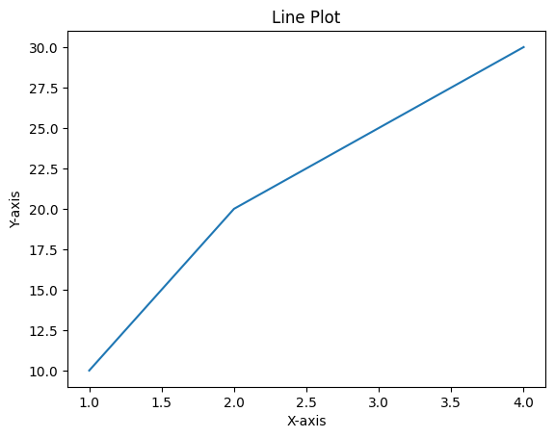
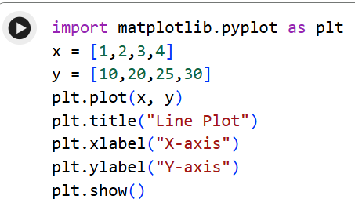
Line Plot:
Shows trends over time or continuous data.
Points connected by straight lines.
Used for time series analysis.

Slide 4
Use Cases:
Temperature over time
Sales growth
Stock prices

Slide 5
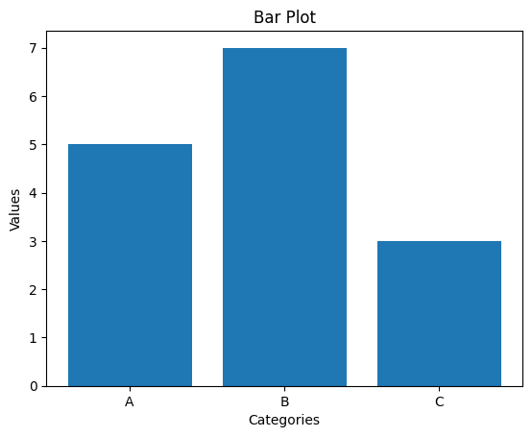
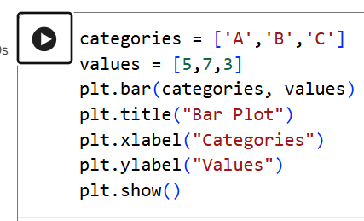
Bar Plot:
Used to compare categories.
Bars represent values.

Slide 6
Use Cases:
Comparing students marks
Sales by product
Population by city

Slide 7
Histogram:
A histogram displays data using bars.
It groups continuous data into intervals (bins).
Each bar shows the frequency (count) of values in that range.
In simple words: A histogram shows how data is spread out.
Example: Marks of students → how many students scored between 0–10, 10–20, 20–30, etc.

Slide 8
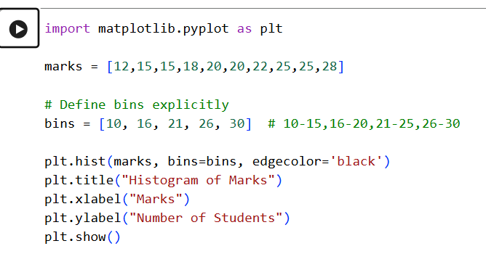
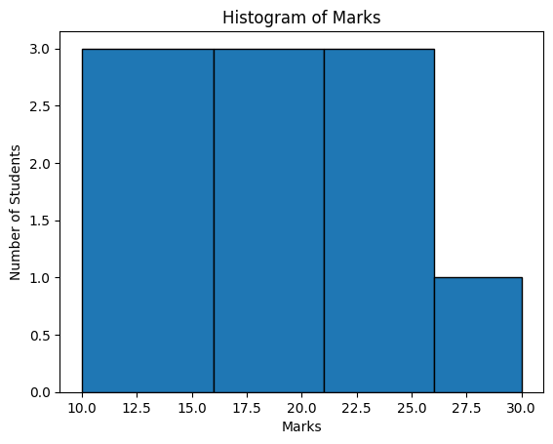
What this does:
Bin 10–16 → 12, 15, 15 → 3 students
Bin 16–21 → 18, 20, 20 → 3 students
Bin 21–26 → 22, 25, 25 → 3 students
Bin 26–30 → 28 → 1 student

Slide 9
Use Cases:
Age distribution
Exam scores
Income distribution

Slide 10
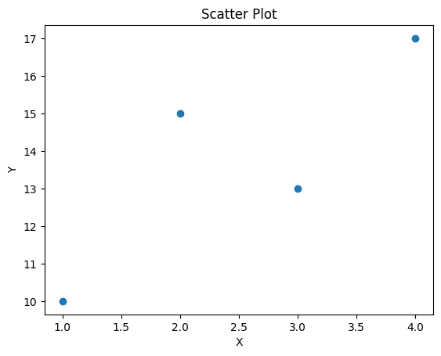
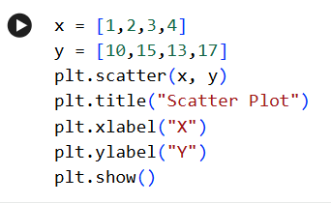
Scatter Plot:
Shows relationship between two variables.
Each point represents data pair.

Slide 11
Use Cases:
Height vs weight
Study time vs marks
Correlation analysis

Slide 12
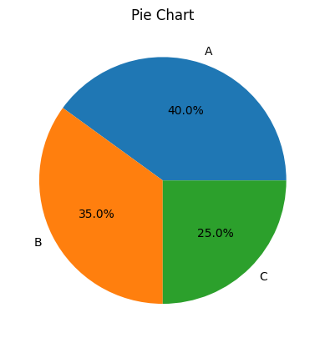
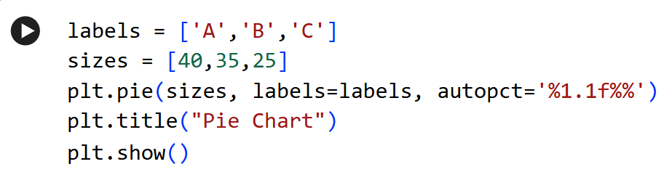
Pie Chart:
Shows percentage distribution.
Circular chart divided into slices.

Slide 13
Use Cases:
Market share
Budget distribution
Survey results

Slide 14
Customizing Plots:
Matplotlib allows customization of:
Title
Axis labels
Colors
Line styles
Markers
Grid
Legend

Slide 15
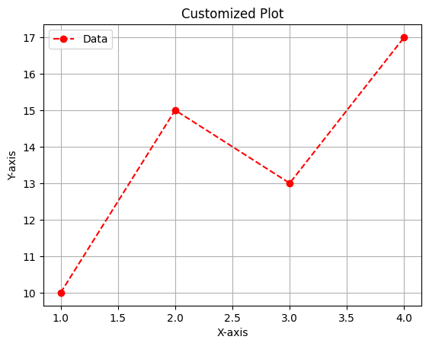
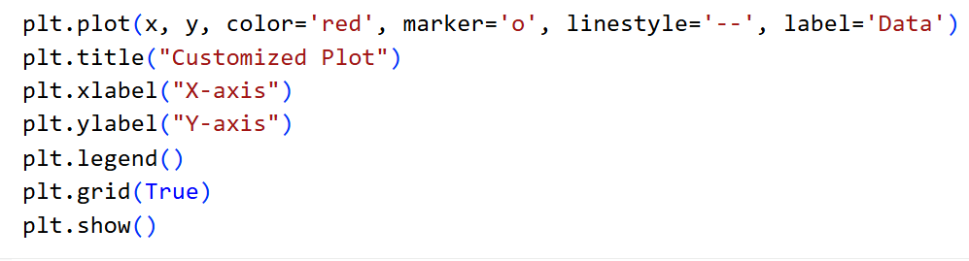

Slide 16
Colors and Styles:
Common color codes:
'r' → red
'g' → green
'b' → blue
Markers:
'o' circle
'*' star
'^' triangle
Line styles:
'-' solid
'--' dashed
':' dotted

Slide 17
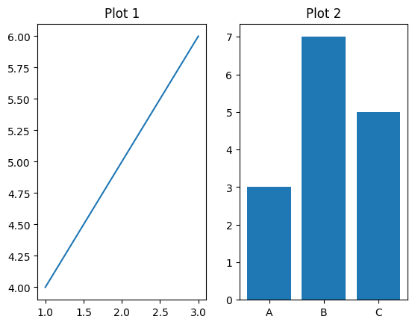
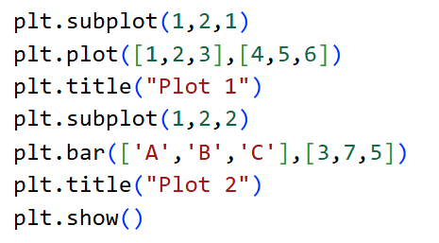
Subplots:
Used to display multiple plots in one figure.
Helps compare graphs.

Slide 18
Advantages of Matplotlib:
Easy to learn
Highly customizable
Works with Pandas & NumPy
Suitable for ML projects
Large community support

